Slide 1
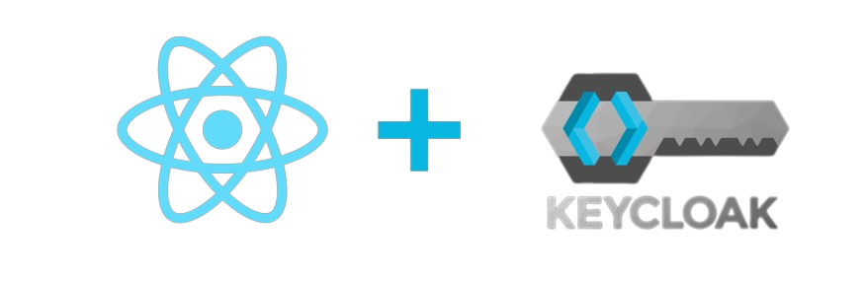
Authentication//Authorization with Keycloak and React App deployment
Presenter:
Software Engineer Tataridis Paris-Rafail

Slide 2
Targets
Learn to code in react. (Front-end)
Create a simple react app.
Learn about Keycloak and its features. (Security)
Implement keycloak auth and role-based access control(rbac) in the simple react app.
Implement keycloak into the Flash-Energy template.
Everything we use in this internship must follow these rules:
Open-source communities.
Reusable modules and procedures.
Scalable for the production environment.

Slide 3
What is Keycloak?
Keycloak is an open-source identity and access management solution that provides secure user authentication, authorization, and single sign-on capabilities for applications and services.
What is React?
React is an open-source JavaScript library used for building user interfaces in web applications, focusing on the efficient rendering of components and managing dynamic UI updates.

Slide 4
What I need to run Keycloak?
Keycloak runs as an image inside a Docker container.
We use this command in terminal to start the image:
docker run -p 8080:8080 -e KEYCLOAK_ADMIN=admin -e KEYCLOAK_ADMIN_PASSWORD=admin quay.io/keycloak/keycloak:22.0.0 start-dev
Full documentation here.
What I need to run React?
React needs Node.js and mpn in order to run the app and install all the required dependencies.
Full code here.

Slide 5


Key keycloak features
Features | Implemented
Single Sign-On (SSO) . Access to multiple applications by a single log in. | Completed
Identity Federation. Enabling users to authenticate through their existing accounts.(SAML,Oauth,OpenID…) | Completed
User Management and Authentication. Offers user management capabilities like user registration, password reset, and multi-factor authentication. | Completed
Realm Authorization and Role-Based Access Control. Admins assign roles to users and control access to specific resources within applications based on user roles and permissions. | Tested
Social Login Integration. Users to sign in using their social media accounts (like Google, Facebook, and Twitter) | Partial Completion

Slide 6
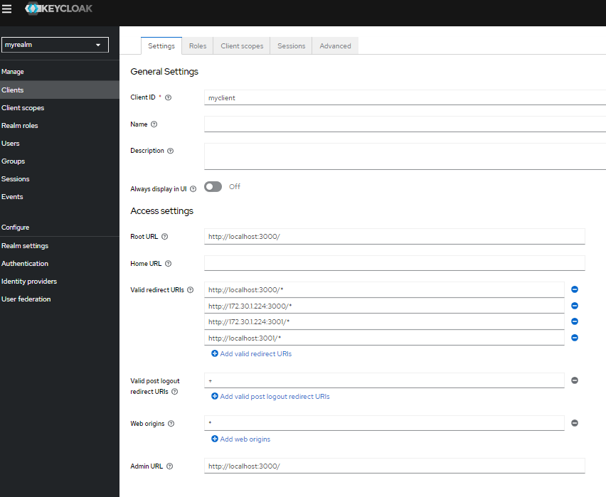
How to set app keycloak in order to connect it to react app.
Keycloak is running at http://localhost:8080/ with the command we used earlier
By default react runs locally at http://localhost:3000/
We make sure to add the required urls to the keycloak client/app.
We are set to call keycloak from react.

Slide 7
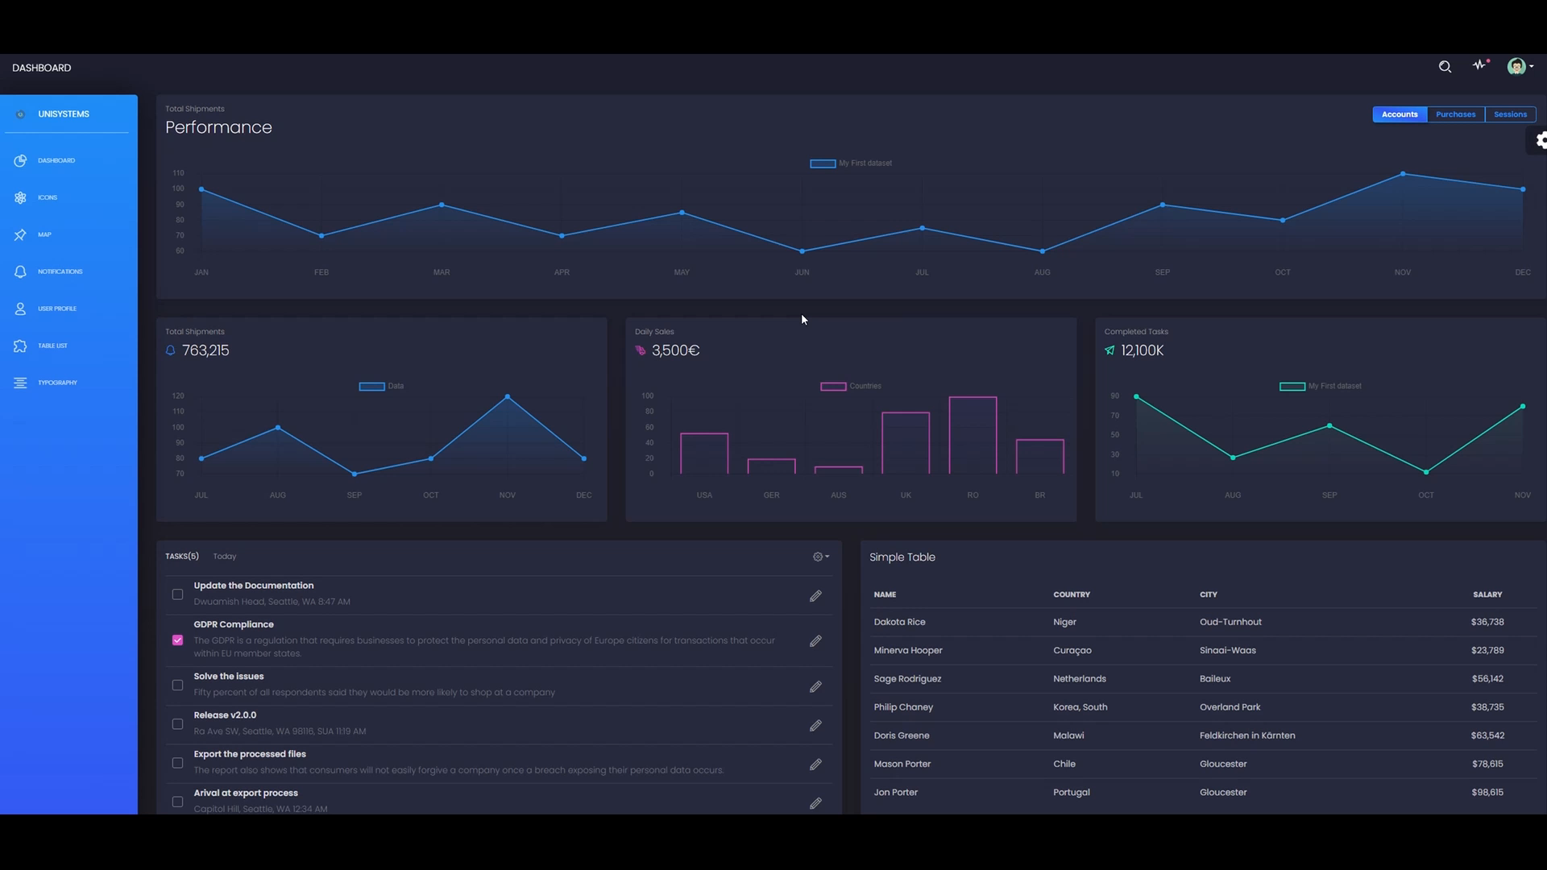
Social Media Login

Slide 8
Key React features
Features | Implemented
Component-Based Architecture. Interfaces are broken down into reusable components. | Completed
Virtual DOM. Changes are first made to a lightweight virtual DOM, and then React efficiently updates the real DOM, minimizing direct manipulations and enhancing performance. | Completed
Unidirectional Data Flow. It makes it easier to understand how data changes and flows through the application. This helps to prevent unexpected side effects and makes debugging more predictable. | Completed
JSX (JavaScript XML). JSX is a syntax extension of JavaScript. It provides a readable and declarative way to define UI elements and their relationships | Rare use
Rich Ecosystem and Community. Vast open-source community. | Heavily used!

Slide 9
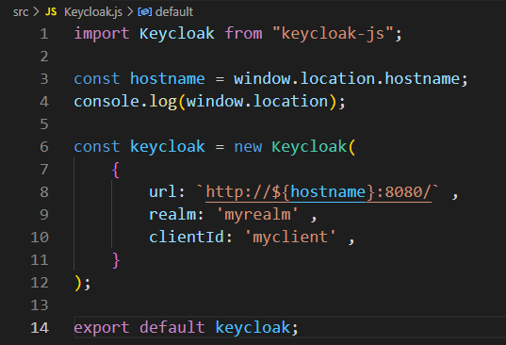
How to implement keycloak in react app
In keycloak we create realms. A realm can contain many apps (or as keycloak calls them clients). Each client/app has a clientId.
In order to use the correct keycloak realm we have to give react some information like shown in the image.
After exporting keycloak. We can import it in any file of the application (react) we want.

Slide 10
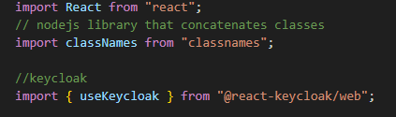
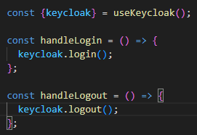
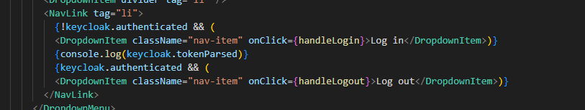
1. Import Keycloak
2. Create login/logout consts
3. Call the consts where needed

Slide 11
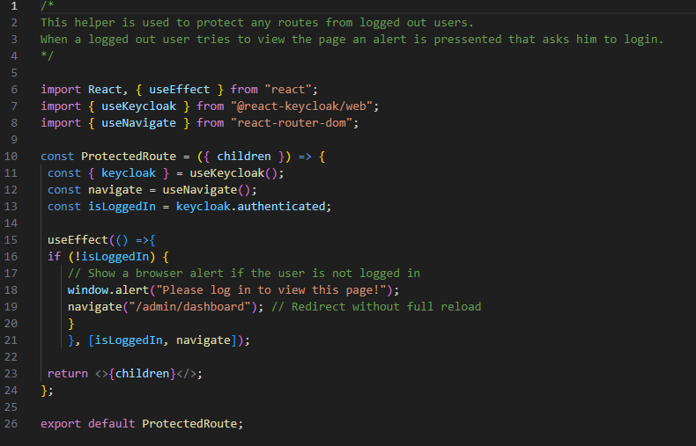
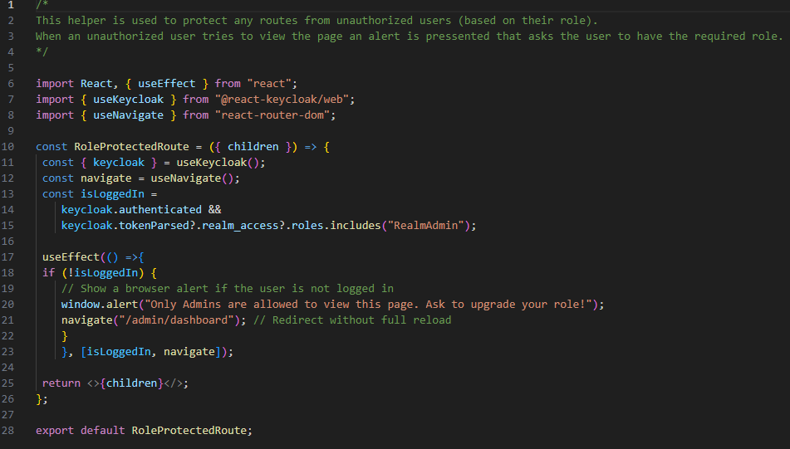
Role-Based Access control with react routing.
We create these helpers in order to protect certain routes in our application.
Most importantly they are reusable in ANY app we want to integrate them.
Login Protected Route
Role Protected Route

Slide 12
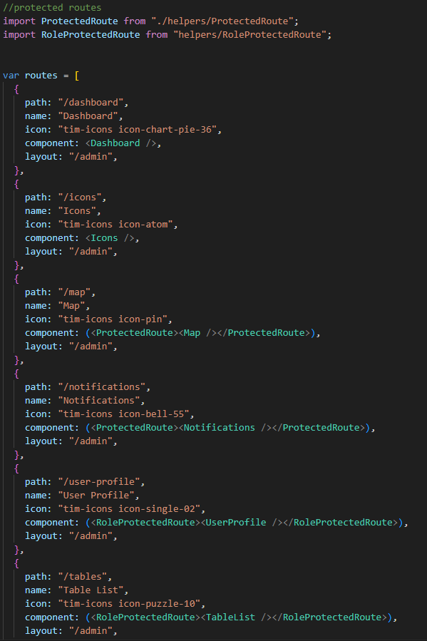
Securing our routes.
We import the helpers.
Protect the Routes with the required security.
Either login based or role based.

Slide 13
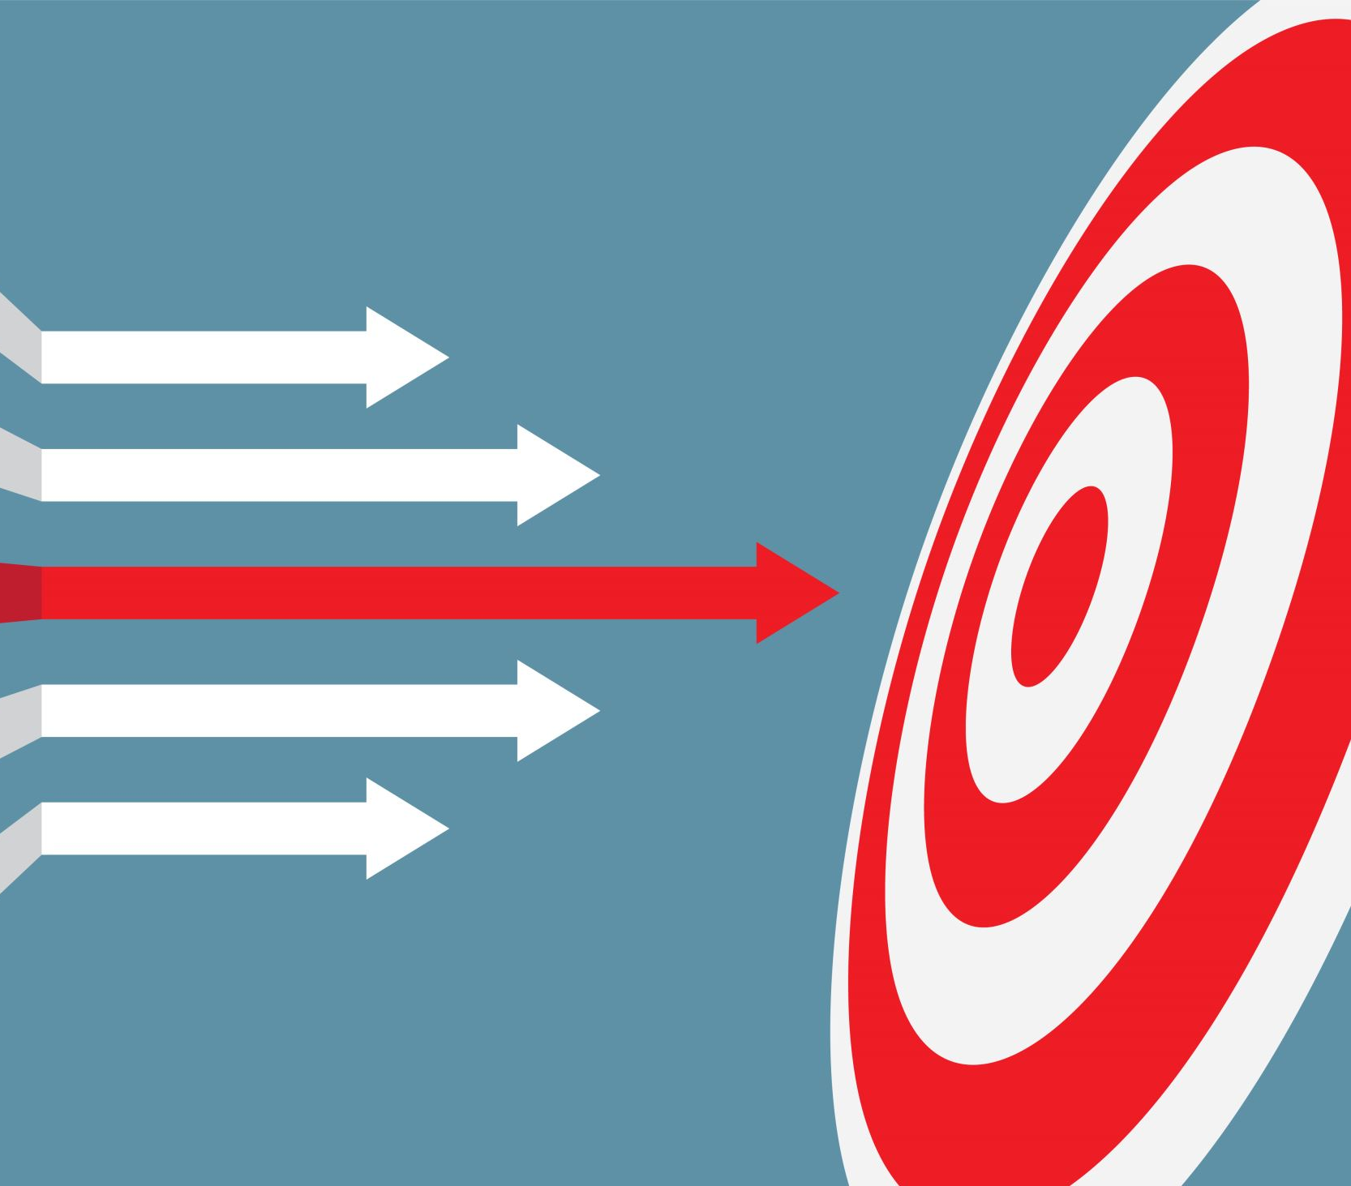
Future Goals
Short Term
Add user personalized widgets with api requests using graphql.
Fully integrate the Flash-Energy project under Keycloak authentication.
Long Term
Learn how to make UI components into a library for usability.
Expand my security knowledge.
Create and Secure a mobile app.

Slide 14
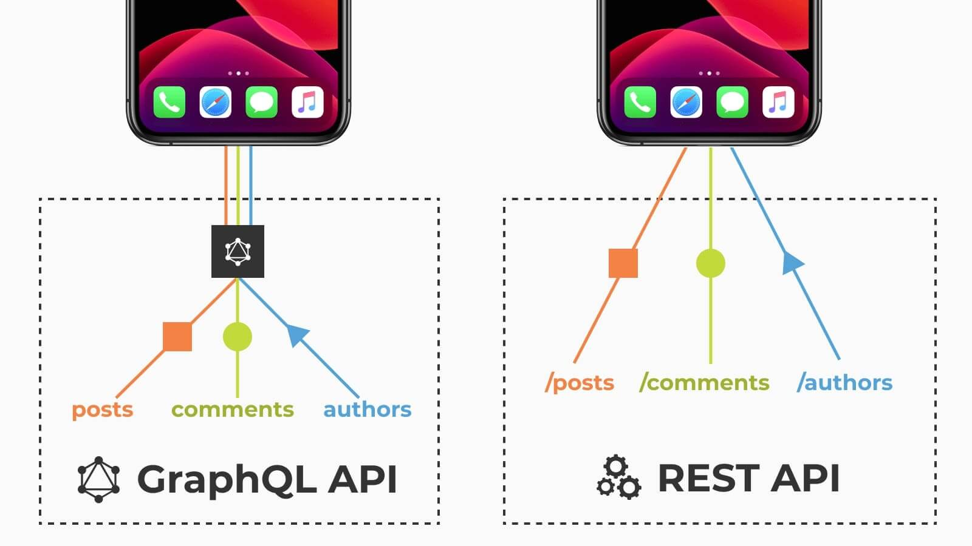
What is GraphQL?
GraphQL is a query language for APIs that enables more efficient and flexible communication between clients and servers by allowing clients to request specific data structures and reducing over-fetching or under-fetching of information.

Slide 15
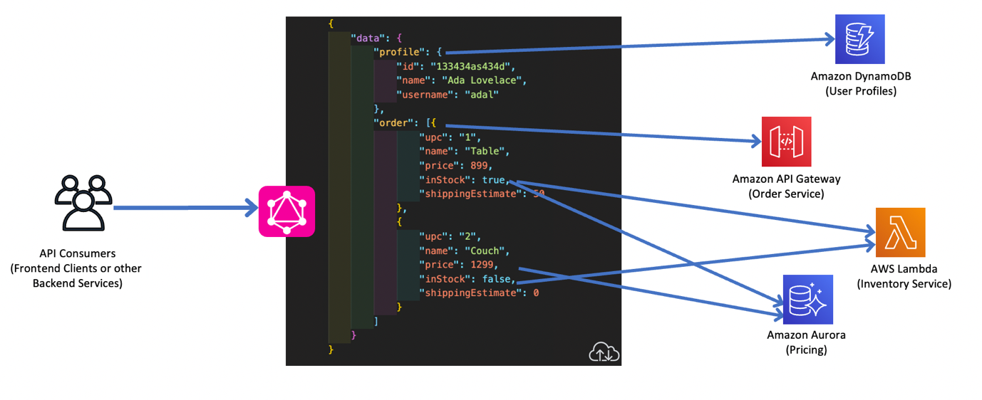
Top Benefits of GraphQL
Allows clients to request only the specific data they need, eliminating over-fetching and under-fetching issues.
Enables clients to retrieve related data in a single query, reducing the need for multiple round-trips to the server
GraphQL APIs are defined using a strongly typed schema, which provides a clear contract between the server and client. (better dev tooling, easier error handling etc)
Clients can specify the exact shape and structure of the response they need. This prevents unnecessary data from being returned, optimizing bandwidth usage and response times.
Eliminates the need for versioning endpoints which leads to continuous developing and smooth transitions to new features.
Full documentation here.

Slide 16

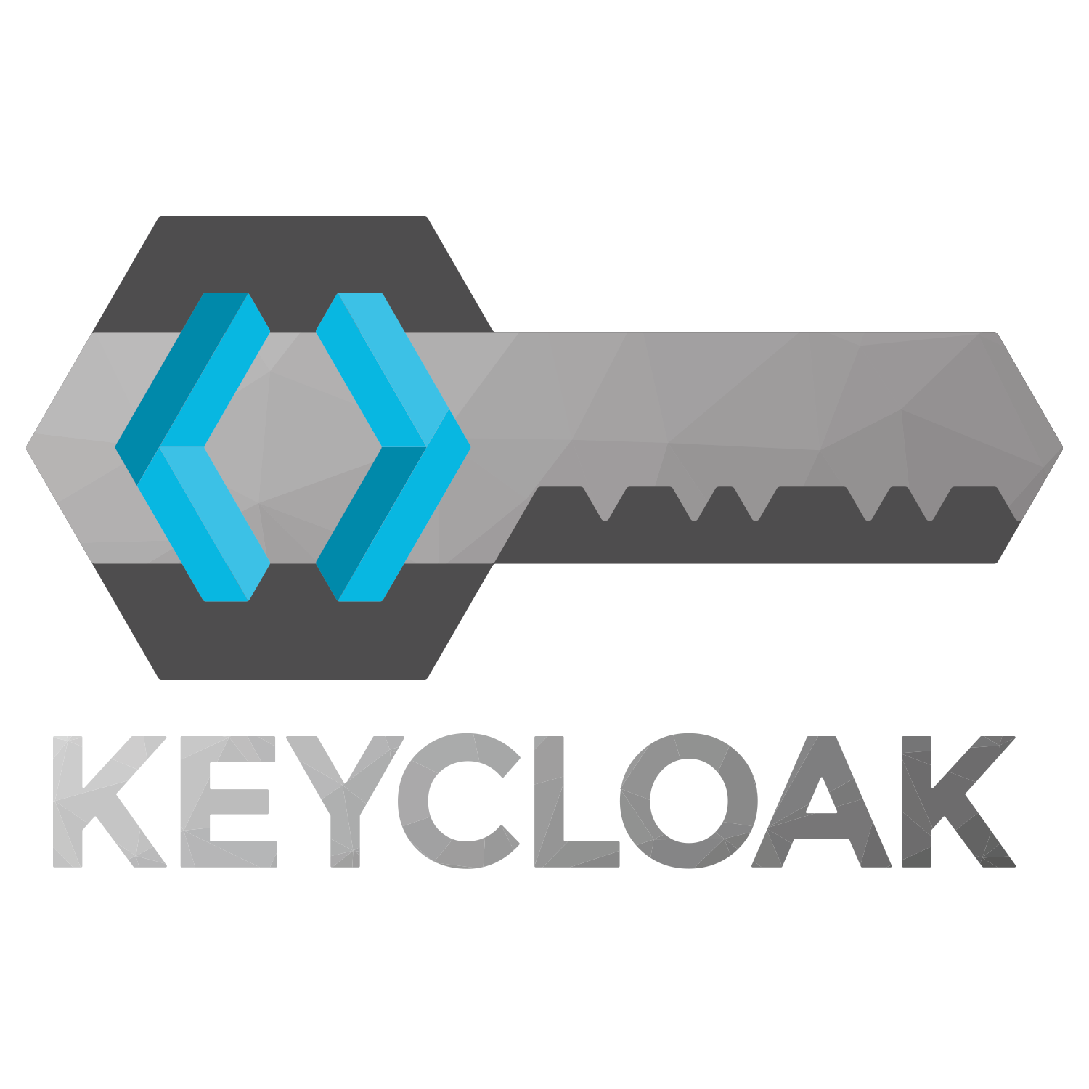
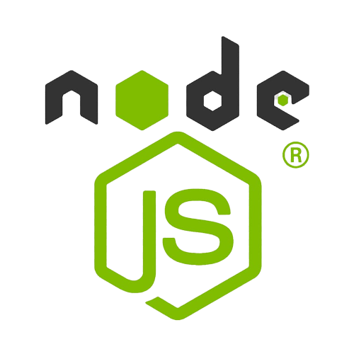

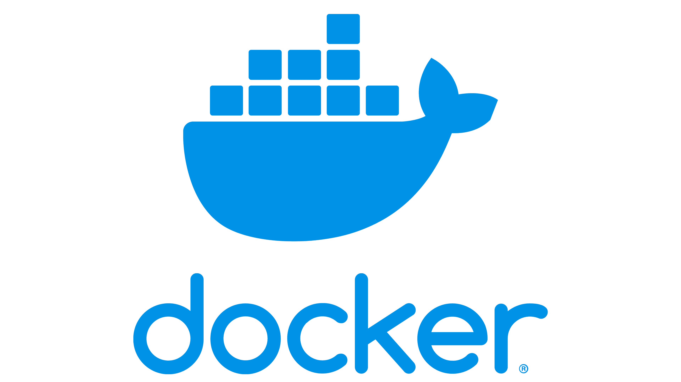

Thank you for your time!
I would like to thank UniSystems for providing everything we needed to develop this application to this point.
Made by Tataridis Paris-Rafail, intern (July-August)
Project Coordinator Ilias Aliferis
Keycloak auth in React Project 2023 @Unisystems, for a better future.

